Slide 1
Sales Forecast & Analytics (ABC MANUFACTURING) DATA SCIENCE PRODEGREE PROJECT
Presented by : GROUP 4 (MS.DIPTI Shinde AND Ms. Zenat Parveen
Guided by : Ms. Sangeeta Rani

Slide 2
Objective :
To analyze and forecast sales of pesticides for a domestic pesticide of manufacturing company (ABC Manufacturing).
To analyze factors that impact the sales such that the company can manage the production to meet growth/slowdown in sales as per sales forecast.
To build data model for the following:
1. To Conduct state wise trend analysis of the given sales.
2.To identify other factors if they are influencing Pesticide sales.
Use of external data such as rainfall to enhance the accuracy of the model.

Slide 3
Pesticides Market Outlook :
Chemical control of pests is a common practice in agriculture.
There are more than a thousand pesticides of both chemical and biological nature, used around the world to minimize crop losses.
Although chemical pesticides are well known for their effectiveness, their impact on soil and environment, and presence of residue in food products are a matter of concern.
Other issues relate to structure of pesticide industry and the regulations for registration and quality assessment.
There are numerous factors affecting sale trends of pesticide, including and not limited to, socio-political factors such as changes in regulation, population growth, rising incomes of population, weather condition, Rainfall, GDP, population etc.;

Slide 4







AGENDA OF PROJECT :
Data Cleaning and Preparation
.
EDA
.
Feature engineering
.
.
Model Building (Selection of techniques)
.
Testing and Validation
.
Final results, recommendations and plots/visualizations.
Insights and analysis from the data which will help the business.

Slide 5
Data Cleaning and preparation
Data shows Data points form April-2014 to Jan -2018
HEAD (First 5 data points)
Date Value (Pesticide Quantity (in tones))
.
TAIL (Last 5 data points)
Date Value (Pesticide Quantity (in tones))
.
2014-04-01 397456.335
2014-05-01 671365.935
2014-06-01 912168.945
2014-07-01 975706.155
2014-08-01 1403217.810
2017-09-01 827022.555
2017-10-01 1145671.290
2017-11-01 1765050.480
2017-12-01 1424822.265
2018-01-01 1041386.625
.
No missing (or NULL ) values found in dataset.

Slide 6
EXPLORATORY DATA ANALYSIS (GRAPHICAL REPRESENTATION & analysis OF PESTICIDES SALES)

Slide 7
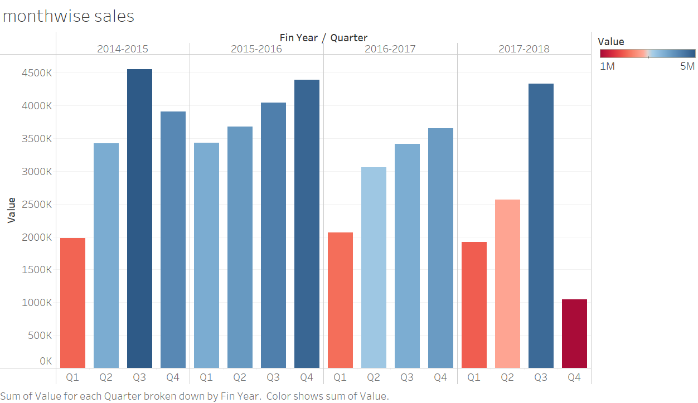
QUARTERLY PESTICIDES SALES ANALYSIS
Pesticide sales is less in Q1 in each financial year.
Trend of the sales is high in Q3.
Highest sales happened in 2014-15 financial year in Q3.
Sales start increasing from Q1 to Q3.

Slide 8
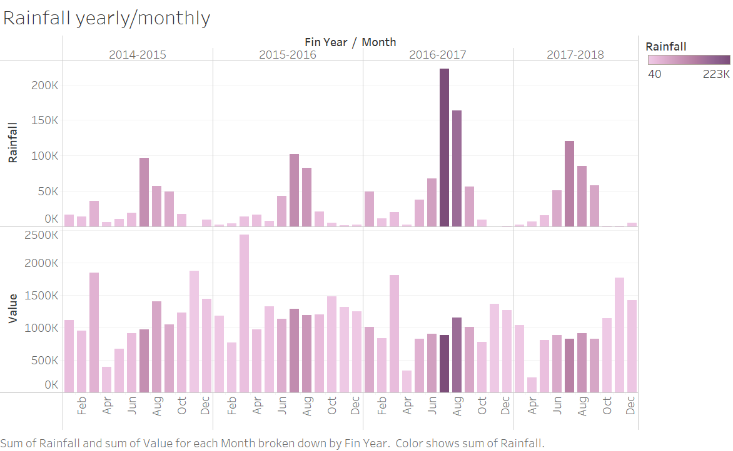
MONTHLY TREND OF PESTICIDES SALES OVER RAINFALL
Trend shows highest pesticides sales is in the month of March and lowest is in April .
Significantly downfall in the sales from April to Jun in each financial year.
Negative correlation shows when it comes to month wise between rainfall and pesticides sales.

Slide 9
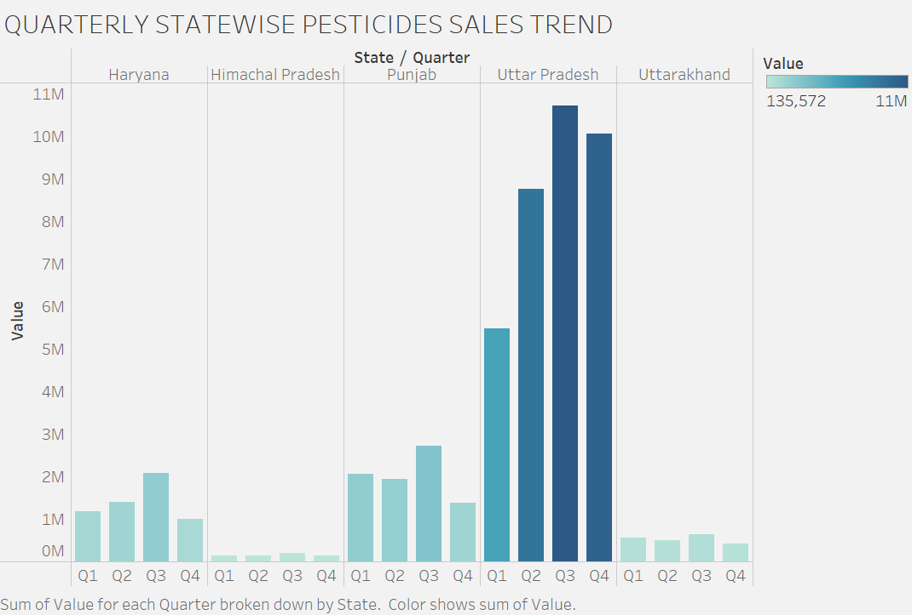
QUARTERLY STATEWISE PESTICIDES SALES TREND
QUARTERLY STATEWISE PESTICIDES SALES TREND
No trend of sales quarterly in Himachal Pradesh and Uttarakhand.
In winter season (Q4), pesticides sales declines in each state.
Highest sales is in Q3 in each state.

Slide 10
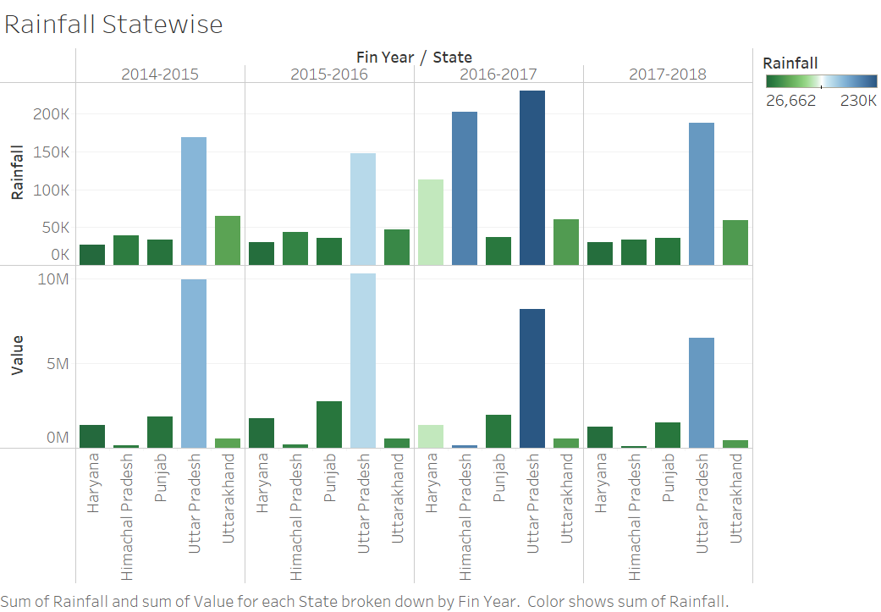
Impact of rainfall over the pesticide sales
Highest pesticides sales is in Uttar Pradesh and lowest is in Himachal Pradesh in each financial year.
There is positive correlation between the rainfall and pesticide sales only in Uttar Pradesh.
There is negative correlation between rainfall and pesticide sales for the state ‘Himachal Pradesh’ and ‘Haryana’.

Slide 11
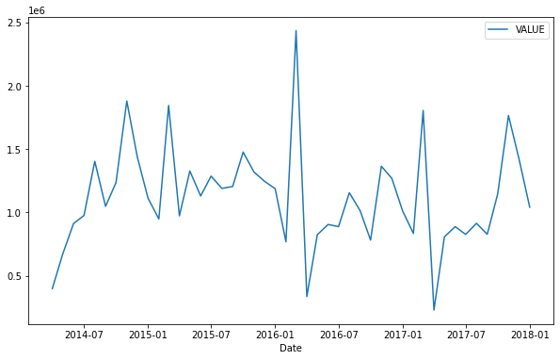
LINE PLOT - Representation of pesticides sales yearly
Since standard deviation is not constant, data doesn’t represent white noise.
Pesticides Sales spikes are high in 2016 quarter 1.
Sales seems stationarity , but there is huge ups and downs in the sales due to factors influences.

Slide 12
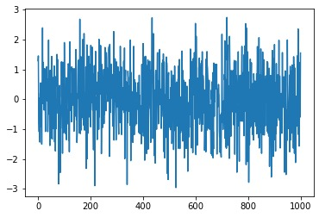
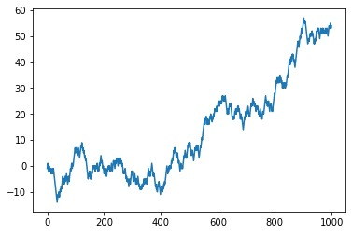
WHITE NOISE AND RANDOM WALK CHECKS
WHITE NOISE
The pesticides sales data set is seems stationary, and does not resemble as the white noise and random walk graphs patterns.
This is a time series type of dataset and its implementable for the future prediction.
PESTICIDE SALES DATASET
RANDOM WALK

Slide 13
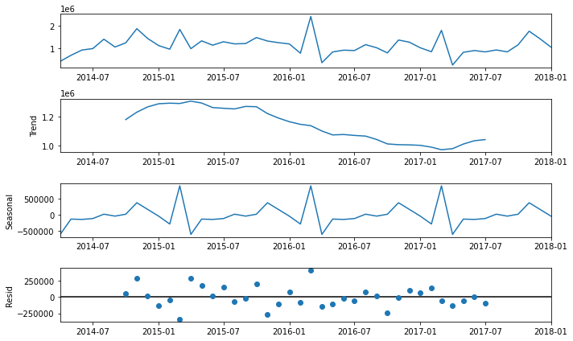
TIME SERIES DECOMPOSITION
Sales sequence are showing trend spikes and troughs.
Trend : Reflects gradual demand for pesticides, and downfall gradually in winter season.
Seasonal : Data is constant, not very exponential increase, additive kind of trend could used.
Residuals : It’s the variability in the data, difference between the observations and the corresponding fitted values

Slide 14
VALIDATION PARAMETERS :
TECHNIQUE USED :
SINGLE EXPONENTIAL SMOOTHING
DOUBLE EXPONENTIAL SMOOTHING
TRIPLE EXPONENTIAL SMOOTHING
ARIMA MODEL
SARIMA MODEL
RMSE
MAPE

Slide 15
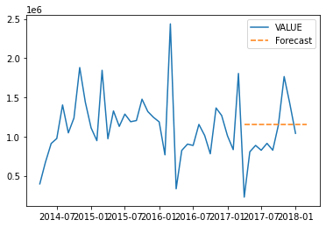
Single Exponential Smoothing (SES)
Orange colour horizontal line represents predicated values generated by simple exponential smoothing model. However, it does not covers trend and seasonality components. Thus this is not an ideal model.
RMSE : 421929.84161649423
MAPE : 64.84891768872035

Slide 16

Double Exponential Smoothing (dES)
DES model could able to capture slight trend component.
Orange colour horizontal line which is slightly inclined which represents there could be trend in the data.
Since seasonality is not taken into consideration this also not an ideal model.
RMSE : 431888.33503336285
MAPE : 66.55151482054387

Slide 17
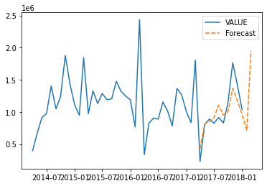
triple Exponential Smoothing (tES)
TES model could able to capture spikes and troughs in the data .
It could also able to identify sales trend within the year.
Seasonality pattern observed is approximately the same as in previous years, hence it is more to the accurate in prediction.
Thus, this is a better model for prediction compared to SES and DES model because RMSE observed low as compared to previous models.
Since this model able to handle trend within year and mainly seasonality, due to which predictions are improvised.
RMSE : 186019.55970135954
MAPE : 19.763474678904874

Slide 18
TEST TO CHECK STAIONARITY IN TIME SERIES
AUGMENTED DICKEY-FULLER (ADF) TEST
CONCLUSION :
Since the P-value is less than 0.05, which means data is rejecting the null hypothesis, hence data is STATIONARITY.

Slide 19
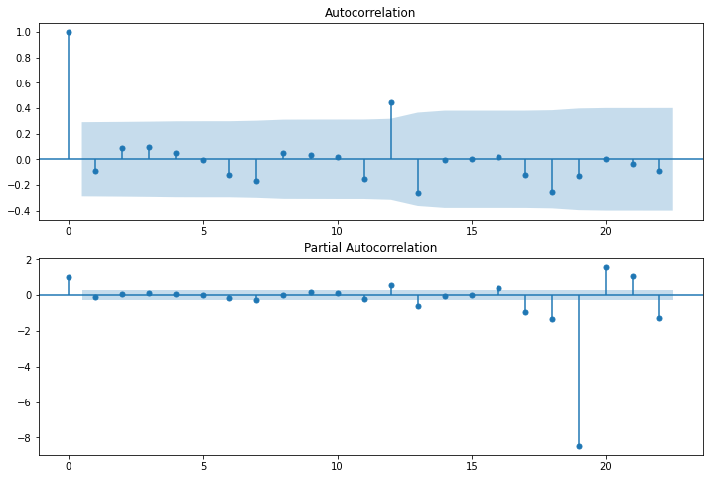
ACF AND PACF INTERPRETATION
The first lag on the ACF plot that crossed the blue threshold is 12, so we will consider q=12.
In PACF, the first lag that almost crosses the blue threshold is 6, so we will consider p=6.

Slide 20
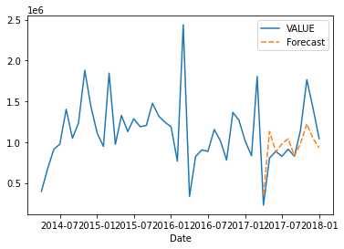
arimaModel1 = ARIMA((6,0,12),(1,0,0,12)).fit(Train)
ARIMA MODEL BUILDING
2017-04-01 228778.560 3.548890e+05
2017-05-01 806600.835 1.129749e+06
2017-06-01 887608.935 8.804534e+05
2017-07-01 826062.030 9.786429e+05
2017-08-01 913790.700 1.042291e+06
2017-09-01 827022.555 8.304911e+05
2017-10-01 1145671.290 9.848292e+05
2017-11-01 1765050.480 1.224837e+06
2017-12-01 1424822.265 1.046266e+06
2018-01-01 1041386.625 9.309167e+05
Orange colour represents predicted values. Its able to capture trend and seasonality components in test financial year.
Predictions on test showing approximately the same trend as that of validation set.
This model could able to predict the seasonality pattern almost similar to validation set i.e, April 2017 to Jan 2018.
Since this model could handle the trend and mainly seasonality, patterns, this model can be use for future predictions.
MAPE: 21.076695223313006
RMSE: 251673.2905875759

Slide 21
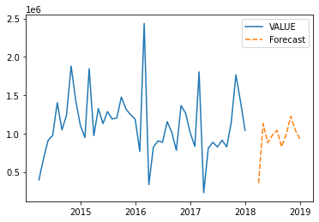
Sales forecast for financial year April 2018 – Jan 2019
ARIMA MODEL
PREDICTED SALES VALUE
2018-04-01 NaN 3.548890e+05
2018-05-01 NaN 1.129749e+06
2018-06-01 NaN 8.804534e+05
2018-07-01 NaN 9.786429e+05
2018-08-01 NaN 1.042291e+06
2018-09-01 NaN 8.304911e+05
2018-10-01 NaN 9.848292e+05
2018-11-01 NaN 1.224837e+06
2018-12-01 NaN 1.046266e+06
2019-01-01 NaN 9.309167e+05

Slide 22
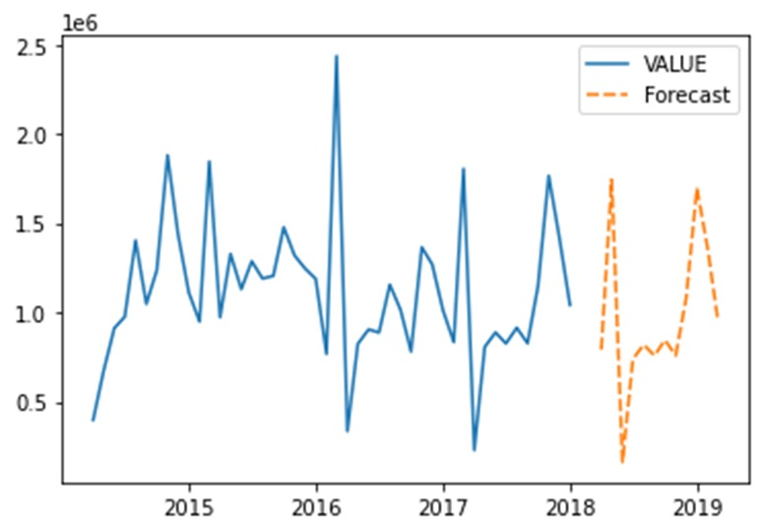
Sales forecast for financial year April 2018 – Jan 2019
SARIMA MODEL
PREDICTED SALES VALUE :
2018-04-01 NaN 7.811594e+05
2018-05-01 NaN 1.753958e+06
2018-06-01 NaN 1.590111e+05
2018-07-01 NaN 7.315009e+05
2018-08-01 NaN 8.111628e+05
2018-09-01 NaN 7.517899e+05
2018-10-01 NaN 8.447966e+05
2018-11-01 NaN 7.565030e+05
2018-12-01 NaN 1.057046e+06
2019-01-01 NaN 1.672414e+06
2019-02-01 NaN 1.341052e+06
2019-03-01 NaN 9.629252e+05
Using grid search ARIMA model gives p,d,q values as : ARIMA(order=(1, 0, 0), seasonal order=(1, 1, 1, 12))
MAPE value observed first 18.6699.
This model could able to predict the seasonality pattern almost similar to validation set i.e, April 2018 to Mar 2019.
Since this model could handle the trend and mainly seasonality, patterns, this model can be use for future predictions.

Slide 23
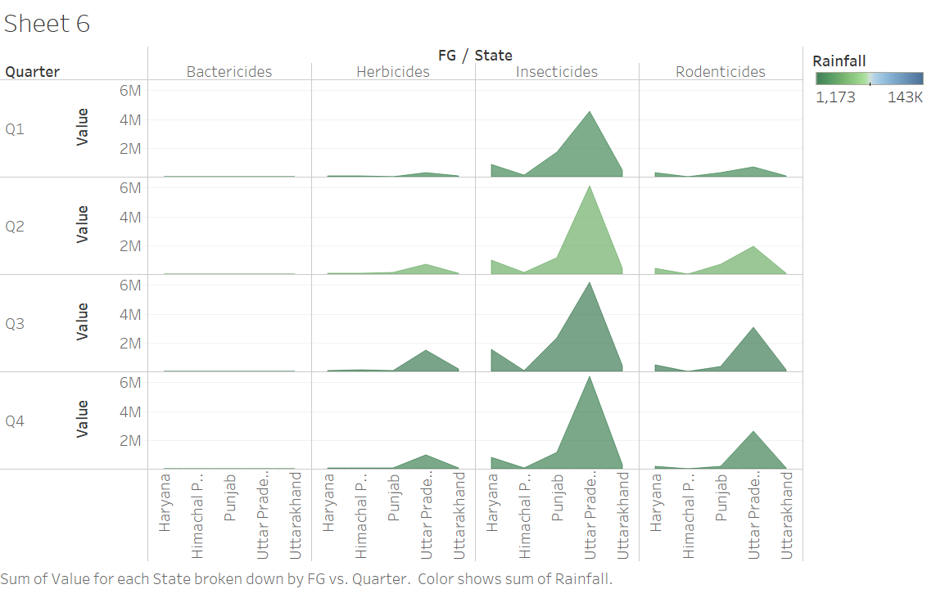
PRODUCTWISE SALES ANALYSIS
INSIGHTS
As there is no sales of bactericides product in any state and quarter so we suggest ABC company to improvise the product as per the demand or stop production of the same.
UP had the highest demand of pesticides of every product except ‘Bactericides’.

Slide 24
Observation and conclusion
Most of the sales of ABC company happened in the Quarter 3 to Quarter 4 so company need to increase the production in those quarters.
As the highest sales happened in Uttar Pradesh and lowest in Himachal Pradesh so ABC company need to do supply changes accordingly.
SALES PREDICTED VALUE
TS ,RW,WN
Among the techniques used, ARIMA model can be use as a better model for future prediction based on RMSE, MAPE and validation parameters

Slide 25
sources
भारत के वर्षा आंकड़े Rainfall Statistics of India - 2014 (environicsindia.in)
https://hydro.imd.gov.in/hydrometweb/(S(5ssokh45alcbz345e5jcvg55))/PRODUCTS/Publications/Rainfall Statistics of India - 2015/Rainfall Statistics of India - 2015.pdf
https://hydro.imd.gov.in/hydrometweb/(S(0ymurl55bikbhgzupnyvnny0))/PRODUCTS/Publications/Rainfall Statistics of India - 2016/Rainfall Statistics of India - 2016.pdf
https://hydro.imd.gov.in/hydrometweb/(S(4pgwda45jih4ls45rp2n1gzy))/PRODUCTS/Publications/Rainfall Statistics of India - 2017/Rainfall Statistics of India - 2017.pdf
https://machinelearningmastery.com/gentle-introduction-random-walk-times-series-forecasting-python/
https://machinelearningmastery.com/white-noise-time-series-python/

Slide 26
THANK YOU

